Slide 1

APEX INSTITUTE OF TECHNOLOGY
DEPARTMENT: CSE
Bachelor of Engineering (Computer Science & Engineering)
Machine Learning
DISCOVER . LEARN . EMPOWER

Slide 2
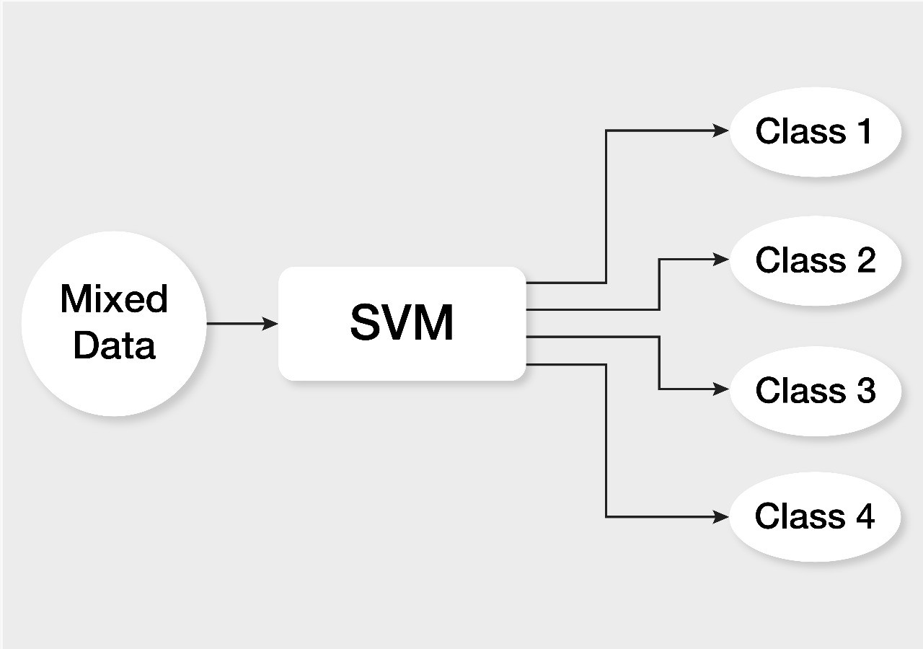
Course Objectives
CO1: To introduce students to the basics of Support Vector Machines .
CO2: To understand concepts of hyperplane.
CO3: To gain experience of doing independent study and research.

Slide 3
Course Outcomes
After this course student will be able to:
Have a good understanding of the SVM.
Appreciate the underlying mathematical difference between line and hyperplane.
Design and implement various SVM for real-world applications.

Slide 4
Support Vector Machine
Support vectors are data points that are closer to the hyperplane and influence the position and orientation of the hyperplane. Using these support vectors, we maximize the margin of the classifier. Deleting the support vectors will change the position of the hyperplane. These are the points that help us build our SVM.

Slide 5
Main Ideas
Max-Margin Classifier
Formalize notion of the best linear separator
Lagrangian Multipliers
Way to convert a constrained optimization problem to one that is easier to solve
Kernels
Projecting data into higher-dimensional space makes it linearly separable
Complexity
Depends only on the number of training examples, not on dimensionality of the kernel space!

Slide 6
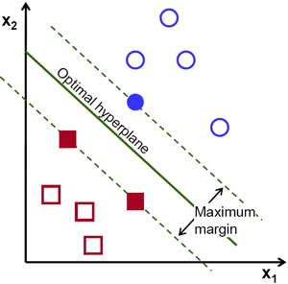
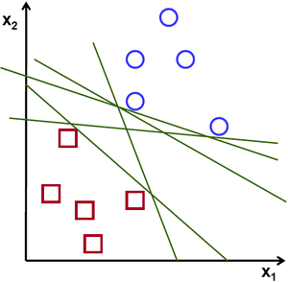
Support Vector Machine: Concept of hyperplane in 2D and 3D
The objective of the support vector machine algorithm is to find a hyperplane in an N-dimensional space(N — the number of features) that distinctly classifies the data points.
Possible hyperplanes
Courtesy: https://towardsdatascience.com/support-vector-machine-introduction-to-machine-learning-algorithms-934a444fca47

Slide 7
Support Vector Machine: Concept of hyperplane in 2D and 3D
To separate the two classes of data points, there are many possible hyperplanes that could be chosen. Our objective is to find a plane that has the maximum margin, i.e. the maximum distance between data points of both classes. Maximizing the margin distance provides some reinforcement so that future data points can be classified with more confidence.

Slide 8
Support Vector Machine: Concept of hyperplane in 2D and 3D
Hyperplanes are decision boundaries that help classify the data points. Data points falling on either side of the hyperplane can be attributed to different classes. Also, the dimension of the hyperplane depends upon the number of features. If the number of input features is 2, then the hyperplane is just a line. If the number of input features is 3, then the hyperplane becomes a two-dimensional plane. It becomes difficult to imagine when the number of features exceeds 3.

Slide 9
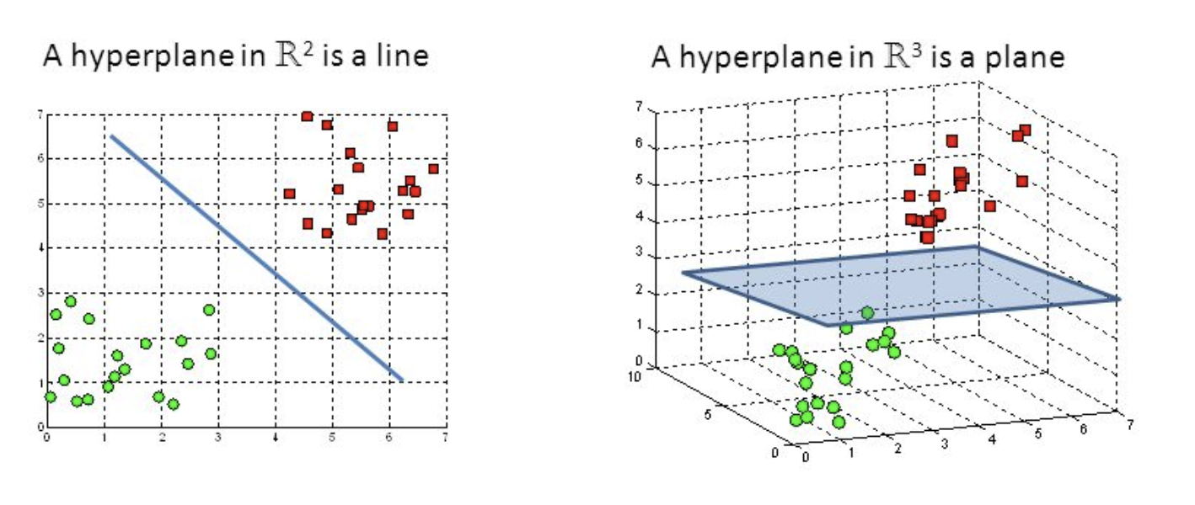
Support Vector Machine: Concept of hyperplane in 2D and 3D

Slide 10
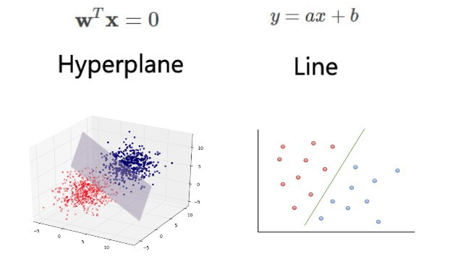
Support Vector Machine: Concept of hyperplane in 2D and 3D

Slide 11
Summary
Support vectors are data points that are closer to the hyperplane and influence the position and orientation of the hyperplane.
Hyperplanes are decision boundaries that help classify the data points. Data points falling on either side of the hyperplane can be attributed to different classes.

Slide 12

References
Mitchell T.M., Machine Learning, McGraw Hill (1997).
Chris Albon - Machine Learning with Python Cookbook_ Practical Solutions from Preprocessing to Deep Learning (2018, O’Reilly Media)
Sebastian Raschka, Vahid Mirjalili - Python Machine Learning_ Machine Learning and Deep Learning with Python, scikit-learn, and TensorFlow 2 (2019, Packt Publishing - ebooks Account)

